Slide 1


FACIAL RECOGNITION ATTENDANCE SYSTEM
Guided By: Dr. Deepti chopra
Group Members
Mrinal()
Namit 02414004421
Akansha 00614004421
Ishaan 02914004421

Slide 2
Description of the Project
Face recognition-based attendance system is a process of recognizing the students face for taking attendance by using face biometrics based on high - definition monitor video and other information technology.
Simply put, a face recognition attendance system makes use of facial recognition technology to identify and verify a person and mark attendance automatically.

Slide 3
The main purpose of this project is to build a face recognition-based attendance monitoring system for educational institution to enhance and upgrade the current attendance system into more efficient and effective as compared to before. The current old system has a lot of ambiguity that caused inaccurate and inefficient of attendance taking. Many problems arise when the authority is unable to enforce the regulation that exist in the old system. The technology working behind will be the face recognition system. The human face is one of the natural traits that can uniquely identify an individual. Therefore, it is used to trace identity as the possibilities for a face to deviate or being duplicated is low. In this project, face databases will be created to pump data into the recognizer algorithm. Then, during the attendance taking session, faces will be compared against the database to seek for identity. When an individual is identified, its attendance will be taken down automatically saving necessary information into a excel sheet. At the end of the day, the excel sheet containing attendance information regarding all individuals are mailed to the respective faculty.

Slide 4
OBJECTIVE
In the 21st century, everything around us has become depends upon technology to make our life much easier. Daily tasks are continuously becoming computerized. Nowadays more people prefer to do their work electronically. To the best of our knowledge, the process of recording students’ attendance at the university is still manual. Lecturers go through manual attendance sheets and signed papers to record attendance. This is slow, inefficient and time consuming. The main objective of this project is to offer system that simplify and automate the process of recording and tracking students’ attendance through face recognition technology. It is biometric technology to identify or verify a person from a digital image or surveillance video. Face recognition is widely used nowadays in different areas such as universities, banks, airports, and offices. We will use preprocessing techniques to detect, recognize and verify the captured faces like Eigenfaces method. We aim to provide a system that will make the attendance process faster and more precisely. The core problem is identified along with solutions and project path.

Slide 5
To develop a portable Smart Attendance System which is handy and self-powered.
▪ To ensure the speed of the attendance recording process is faster than the previous system which can go as fast as approximately 3 second for each student.
▪ Have enough memory space to store the database.
▪Able to recognize the face of an individual accurately based on the face database.
▪ Develop a database for the attendance management system.
▪ Provide a user-friendly interface for admins to access the attendance database andfor non-admins (parents) to check their child‟s attendance by mailing the attendance.
▪ Allow new students or staff to store their faces in the database by using a GUI.
▪ Able to show an indication to the user whether the face- recognition process is successful or not.

Slide 6
Instead of using the conventional methods, this proposed system aims to develop an automated system that records the student's attendance by using facial recognition technology. The main objective of this work is to make the attendance marking and management system efficient, time saving, simple and easy.

Slide 7
Technology Used (Both Hardware and Software)

Slide 8
Role of Team members

Slide 9
Modules and Brief Description of that

Slide 10
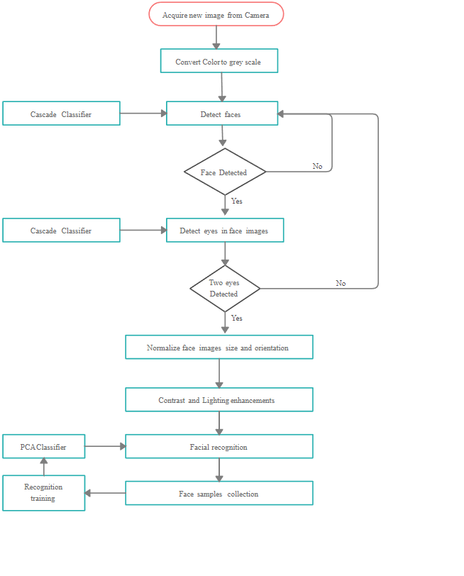
Working of the System
CHART OF IMAGE PROCESSING:-

Slide 11
Database Tables

Slide 12
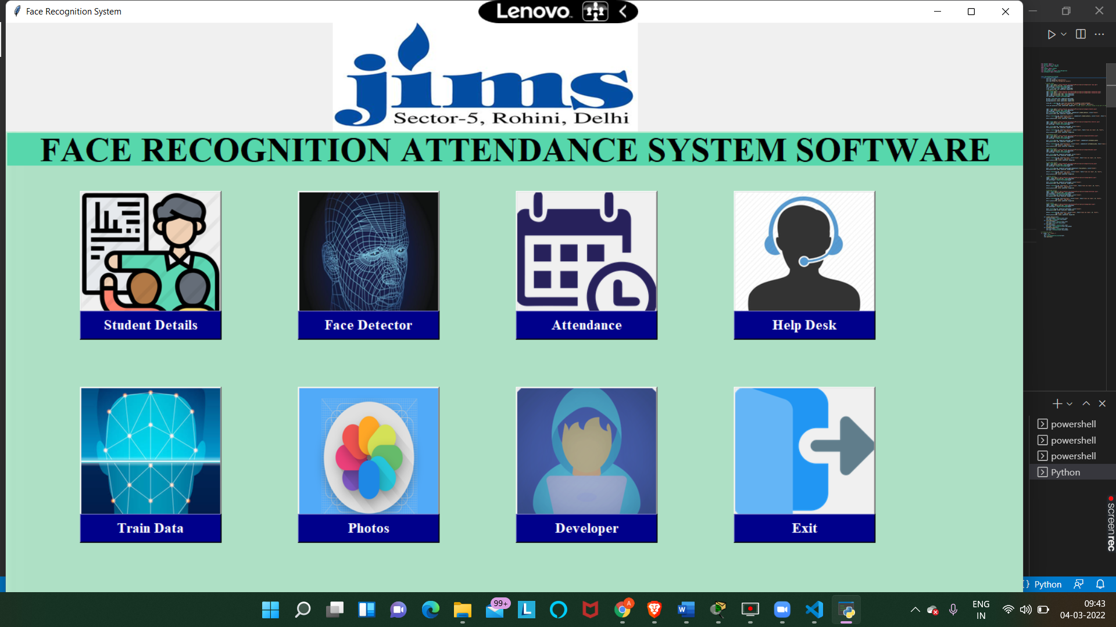
Output Screens

Slide 13
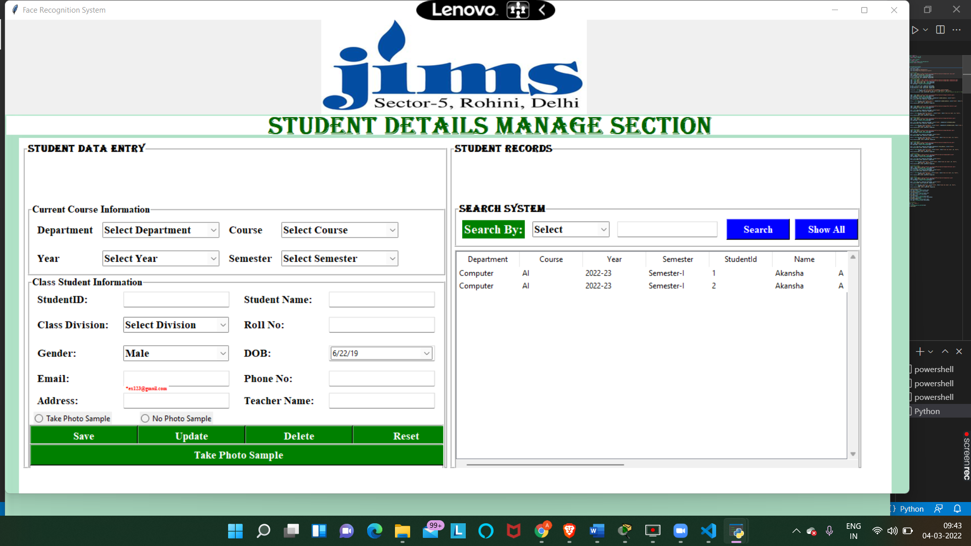

Slide 14
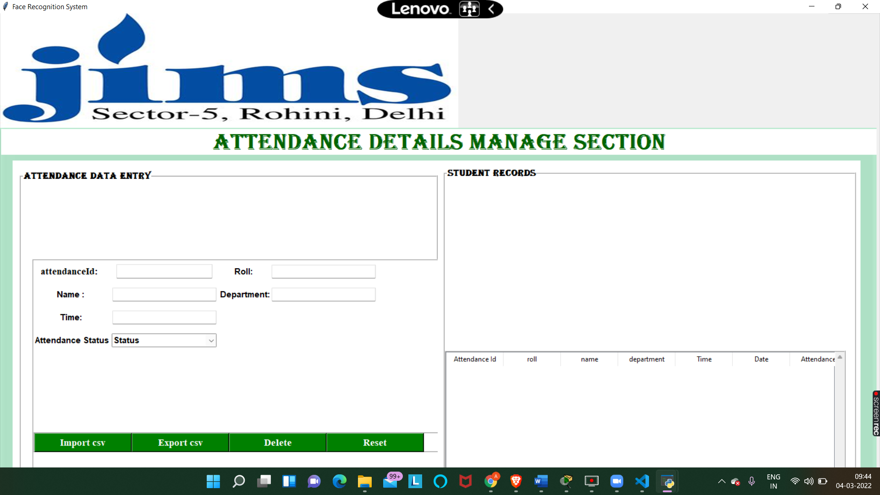

Slide 15
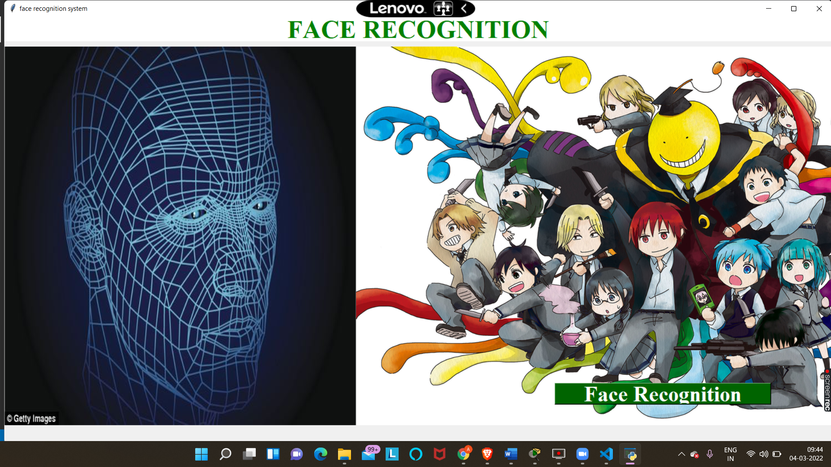

Slide 16
Future Scope
Though there are some weaknesses of facial recognition system, there is a tremendous scope in India.
A possible future application for facial recognition systems lies in retailing. A retail store (for example, a grocery store) may have cash registers equipped with cameras; the cameras would be aimed at the faces of customers, so pictures of customers could be obtained. The camera would be the primary means of identifying the customer, and if visual identification failed, the customer could complete the purchase by using a PIN (personal identification number).

Slide 17
In order to prevent the frauds of ATM in India, it is recommended to prepare the database of all ATM customers with the banks in India & deployment of high resolution camera and face recognition software at all ATMs. So, whenever user will enter in ATM his photograph will be taken to permit the access after it is being matched with stored photo from the database.
Duplicate voter are being reported in India. To prevent this, a database of all voters, of course, of all constituencies, is recommended to be prepared. Then at the time of voting the resolution camera and face recognition equipped of voting site will accept a subject face 100% and generates the recognition for voting if match is found.

Slide 18


